Slide 1


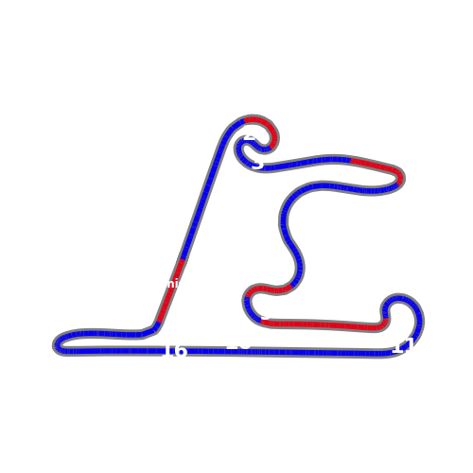
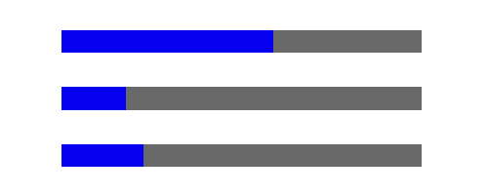

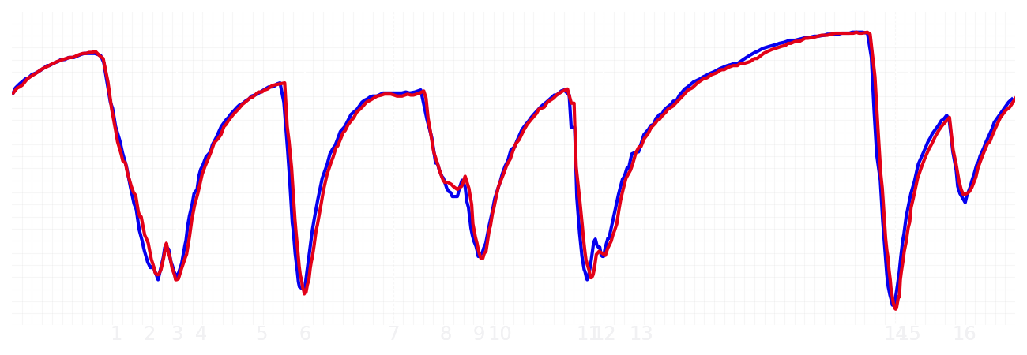
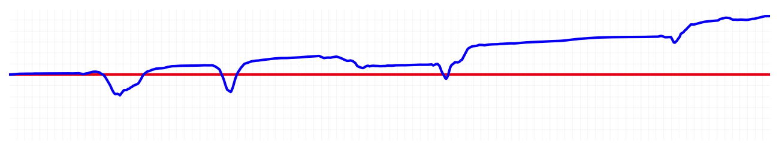
Chinese GP Sprint Quali Q1
Max Verstappen
Driver
Liam Lawson
Driver
Lap Time
01:31.916
01:32.729
Lap Time
Sector 1
24.533
Speed Trap 1
281 kp/h
Speed Trap 1
281 kp/h
Sector 1
24.780
Sector 2
27.634
Speed Trap 2
274 kp/h
Gap
-0.813
Gap
0.813
Speed Trap 2
276 kp/h
Sector 2
27.669
Sector 3
39.749
Speed Final Line
268 kp/h
Corner Advantage
4/17
Corner Advantage
13/17
Speed Final Line
267 kp/h
Sector 3
40.280
FULL THROTTLE
59%
57%
FULL THROTTLE
HEAVY BREAKING
18%
19%
HEAVY BREAKING
%LAP TIME
CORNERING
23%
24%
CORNERING
%LAP TIME
SPEED
SPEED
DELTA TIME
DELTA TIME

Slide 2

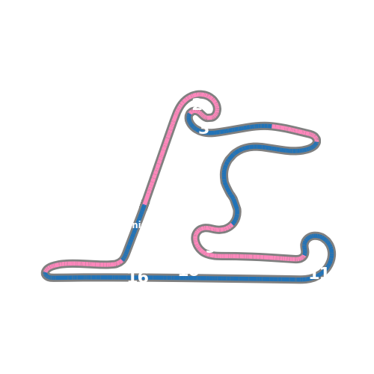


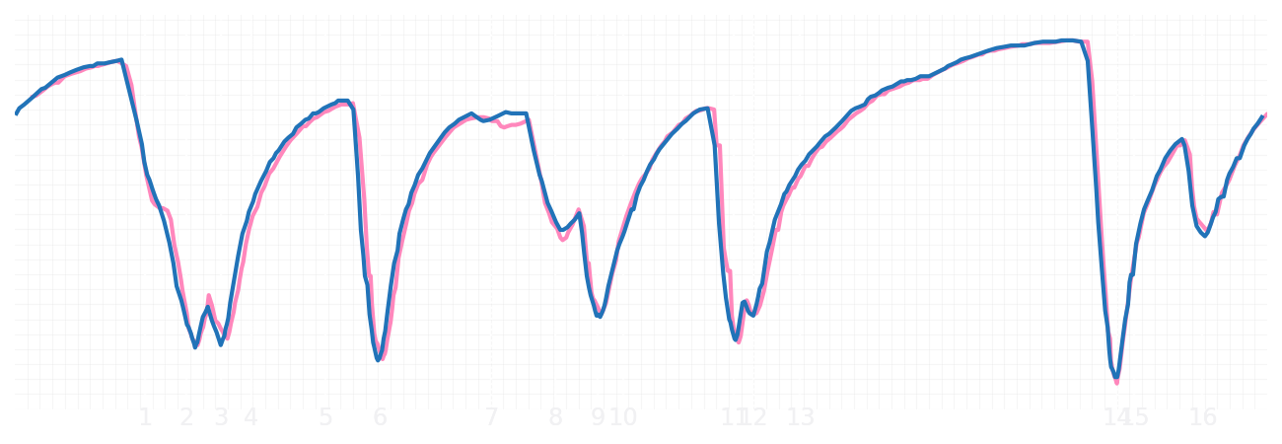
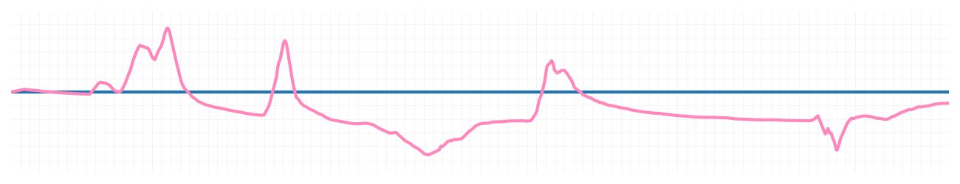
Chinese GP Sprint Quali Q1
Pierre Gasly
Driver
Jack Doohan
Driver
Lap Time
01:32.640
01:32.575
Lap Time
Sector 1
24.918
Speed Trap 1
279 kp/h
Speed Trap 1
280 kp/h
Sector 1
24.609
Sector 2
27.828
Speed Trap 2
275 kp/h
Gap
0.065
Gap
-0.065
Speed Trap 2
274 kp/h
Sector 2
27.945
Sector 3
39.894
Speed Final Line
268 kp/h
Corner Advantage
7/17
Corner Advantage
10/17
Speed Final Line
268 kp/h
Sector 3
40.021
FULL THROTTLE
60%
56%
FULL THROTTLE
HEAVY BREAKING
15%
18%
HEAVY BREAKING
%LAP TIME
CORNERING
25%
26%
CORNERING
%LAP TIME
SPEED
SPEED
DELTA TIME
DELTA TIME

Slide 3

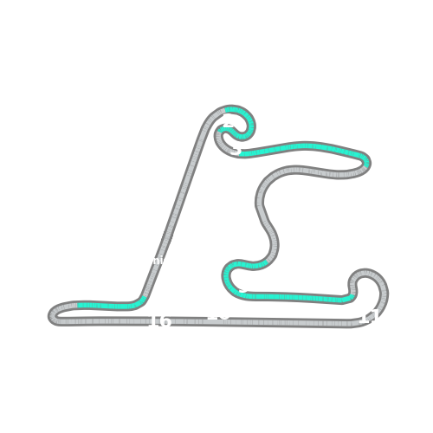


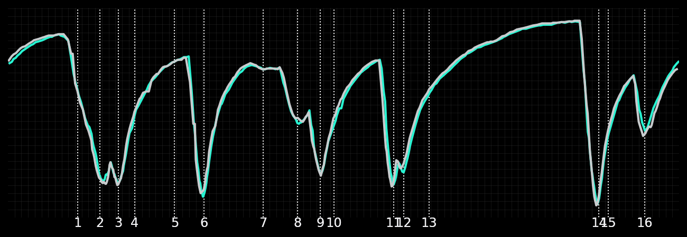
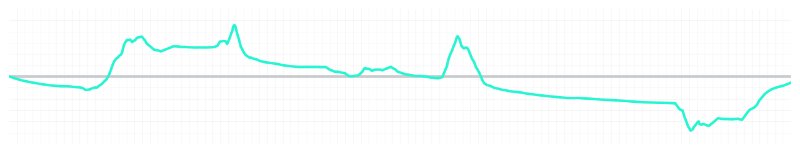
Chinese GP Sprint Quali Q1
Kimi Antonelli
Driver
George Russell
Driver
Lap Time
01:31.999
01:31.952
Lap Time
Sector 1
24.477
Speed Trap 1
281 kp/h
Speed Trap 1
280 kp/h
Sector 1
24.605
Sector 2
27.850
Speed Trap 2
274 kp/h
Gap
0.047
Gap
-0.047
Speed Trap 2
276 kp/h
Sector 2
27.622
Sector 3
39.672
Speed Final Line
272 kp/h
Corner Advantage
8/17
Corner Advantage
9/17
Speed Final Line
264 kp/h
Sector 3
39.725
FULL THROTTLE
54%
57%
FULL THROTTLE
HEAVY BREAKING
20%
20%
HEAVY BREAKING
%LAP TIME
CORNERING
26%
23%
CORNERING
%LAP TIME
SPEED
SPEED
DELTA TIME
DELTA TIME

Slide 4

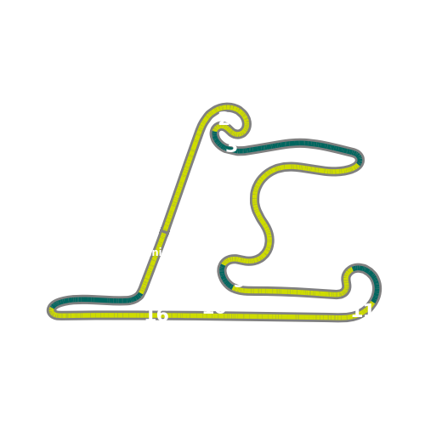


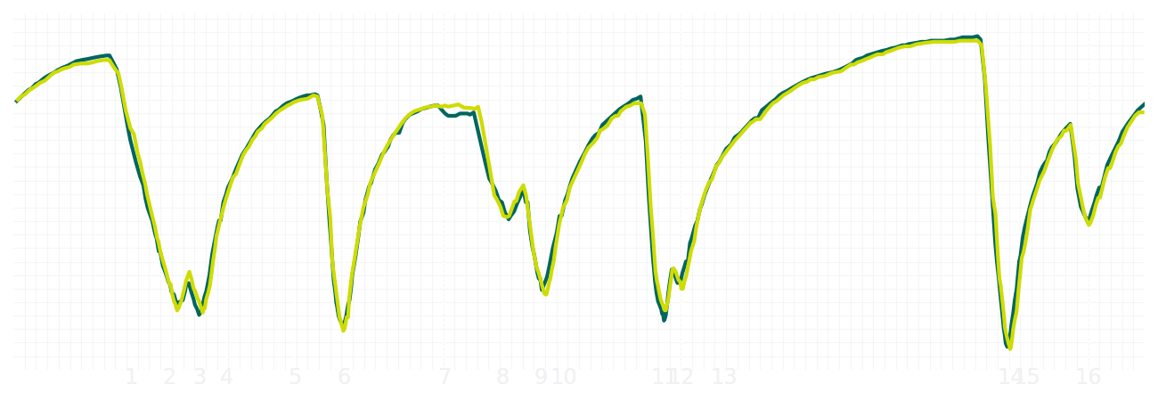
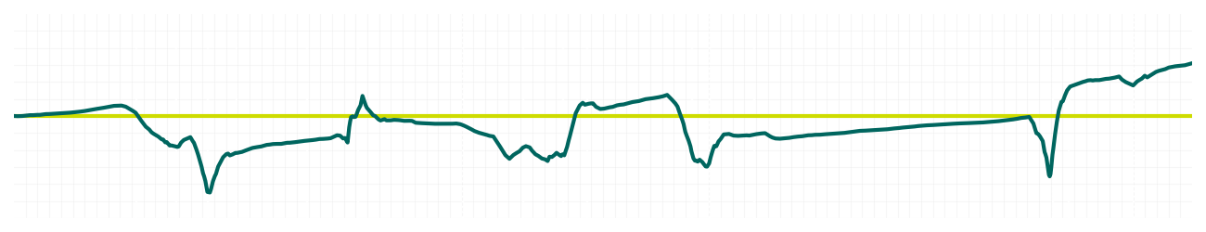
Chinese GP Sprint Quali Q1
Fernando Alonso
Driver
Lance Stroll
Driver
Lap Time
01:32.121
01:32.327
Lap Time
Sector 1
24.449
Speed Trap 1
282 kp/h
Speed Trap 1
280 kp/h
Sector 1
24.369
Sector 2
27.760
Speed Trap 2
276 kp/h
Gap
-0.206
Gap
0.206
Speed Trap 2
274 kp/h
Sector 2
27.902
Sector 3
39.912
Speed Final Line
270 kp/h
Corner Advantage
9/17
Corner Advantage
8/17
Speed Final Line
270 kp/h
Sector 3
40.056
FULL THROTTLE
58%
60%
FULL THROTTLE
HEAVY BREAKING
17%
18%
HEAVY BREAKING
%LAP TIME
CORNERING
25%
22%
CORNERING
%LAP TIME
SPEED
SPEED
DELTA TIME
DELTA TIME

Slide 5

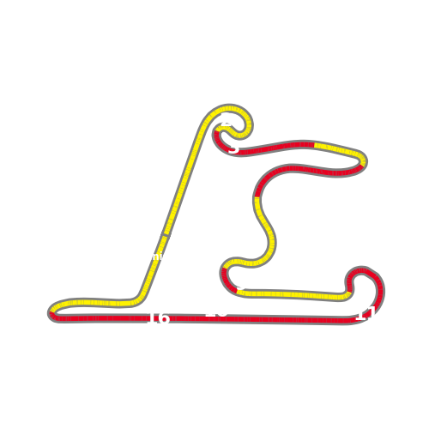


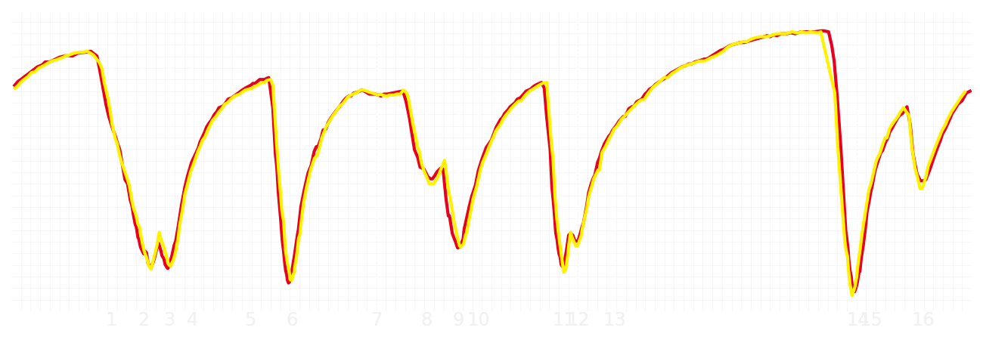
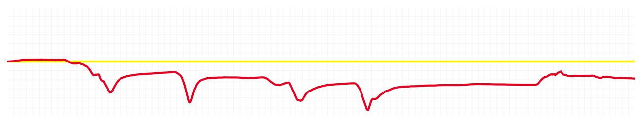
Chinese GP Sprint Quali Q1
Charles Leclerc
Driver
Lewis Hamilton
Driver
Lap Time
01:31.518
01:31.212
Lap Time
Sector 1
24.511
Speed Trap 1
282 kp/h
Speed Trap 1
280 kp/h
Sector 1
24.415
Sector 2
27.601
Speed Trap 2
277 kp/h
Gap
0.306
Gap
-0.306
Speed Trap 2
276 kp/h
Sector 2
27.428
Sector 3
39.406
Speed Final Line
270 kp/h
Corner Advantage
10/17
Corner Advantage
7/17
Speed Final Line
272 kp/h
Sector 3
39.369
FULL THROTTLE
56%
59%
FULL THROTTLE
HEAVY BREAKING
19%
24%
HEAVY BREAKING
%LAP TIME
CORNERING
25%
17%
CORNERING
%LAP TIME
SPEED
SPEED
DELTA TIME
DELTA TIME

Slide 6

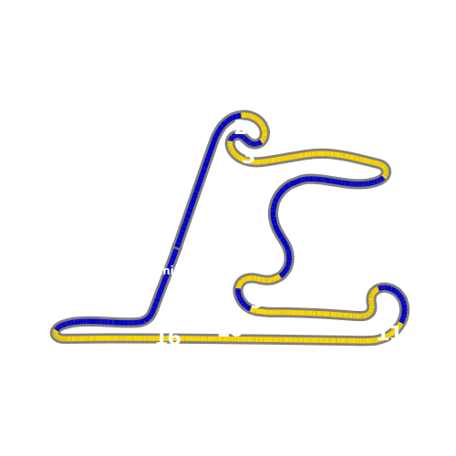

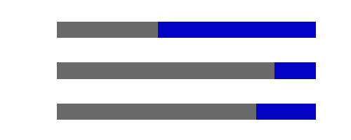
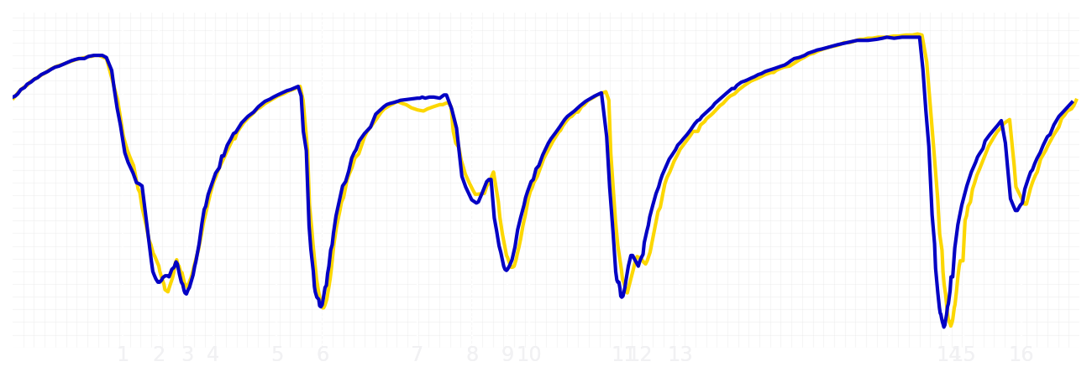
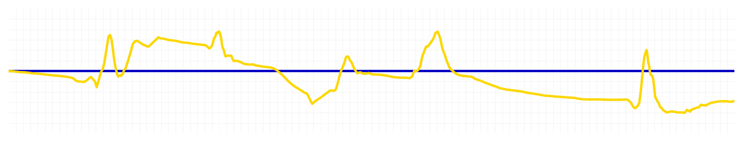
Chinese GP Sprint Quali Q1
Yuki Tsunoda
Driver
Isack Hadjar
Driver
Lap Time
01:32.316
01:32.171
Lap Time
Sector 1
24.554
Speed Trap 1
281 kp/h
Speed Trap 1
281 kp/h
Sector 1
24.657
Sector 2
27.838
Speed Trap 2
276 kp/h
Gap
0.145
Gap
-0.145
Speed Trap 2
274 kp/h
Sector 2
27.677
Sector 3
39.924
Speed Final Line
270 kp/h
Corner Advantage
8/17
Corner Advantage
9/17
Speed Final Line
266 kp/h
Sector 3
39.837
FULL THROTTLE
57%
61%
FULL THROTTLE
HEAVY BREAKING
20%
16%
HEAVY BREAKING
%LAP TIME
CORNERING
23%
23%
CORNERING
%LAP TIME
SPEED
SPEED
DELTA TIME
DELTA TIME

Slide 7

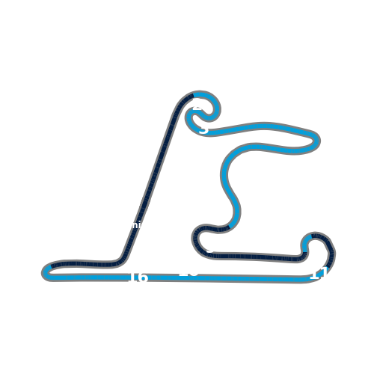


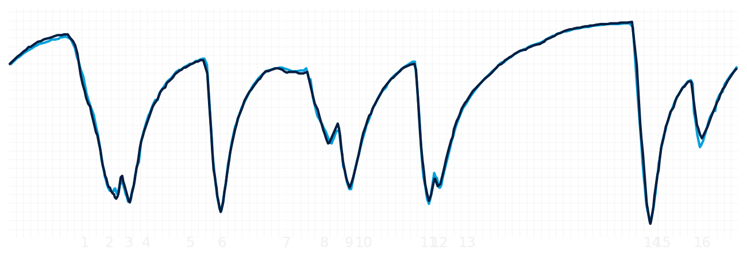
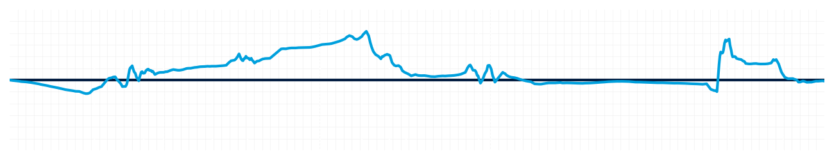
Chinese GP Sprint Quali Q1
Alexander Albon
Driver
Carlos Sainz
Driver
Lap Time
01:32.462
01:32.457
Lap Time
Sector 1
24.490
Speed Trap 1
281 kp/h
Speed Trap 1
280 kp/h
Sector 1
24.601
Sector 2
27.932
Speed Trap 2
276 kp/h
Gap
0.005
Gap
-0.005
Speed Trap 2
274 kp/h
Sector 2
27.883
Sector 3
40.040
Speed Final Line
271 kp/h
Corner Advantage
8/17
Corner Advantage
9/17
Speed Final Line
270 kp/h
Sector 3
39.973
FULL THROTTLE
54%
60%
FULL THROTTLE
HEAVY BREAKING
21%
22%
HEAVY BREAKING
%LAP TIME
CORNERING
25%
18%
CORNERING
%LAP TIME
SPEED
SPEED
DELTA TIME
DELTA TIME

Slide 8

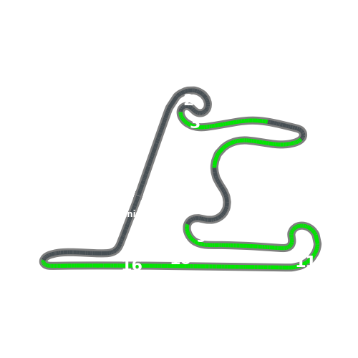


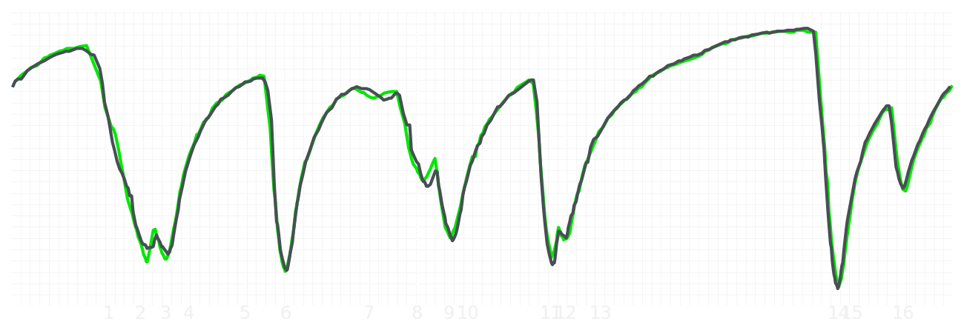
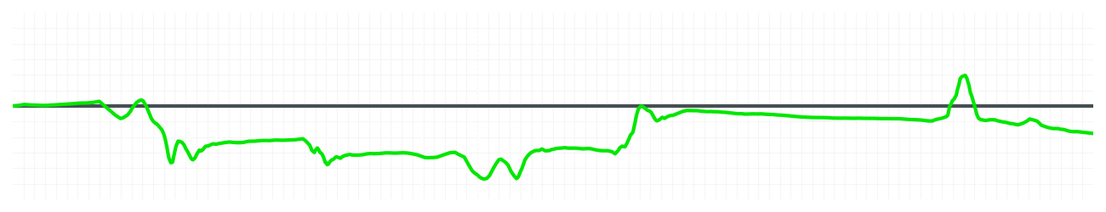
Chinese GP Sprint Quali Q1
Nico Hulkenberg
Driver
Gabriel Bortoleto
Driver
Lap Time
01:32.675
01:32.539
Lap Time
Sector 1
24.606
Speed Trap 1
281 kp/h
Speed Trap 1
281 kp/h
Sector 1
24.608
Sector 2
27.906
Speed Trap 2
276 kp/h
Gap
0.136
Gap
-0.136
Speed Trap 2
276 kp/h
Sector 2
27.854
Sector 3
40.163
Speed Final Line
270 kp/h
Corner Advantage
9/17
Corner Advantage
8/17
Speed Final Line
270 kp/h
Sector 3
40.077
FULL THROTTLE
56%
56%
FULL THROTTLE
HEAVY BREAKING
18%
17%
HEAVY BREAKING
%LAP TIME
CORNERING
26%
27%
CORNERING
%LAP TIME
SPEED
SPEED
DELTA TIME
DELTA TIME

Slide 9

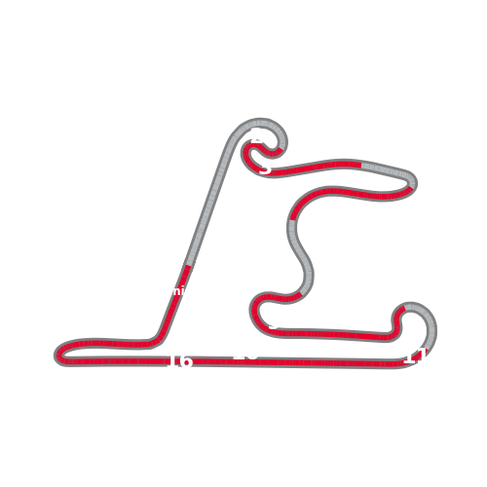


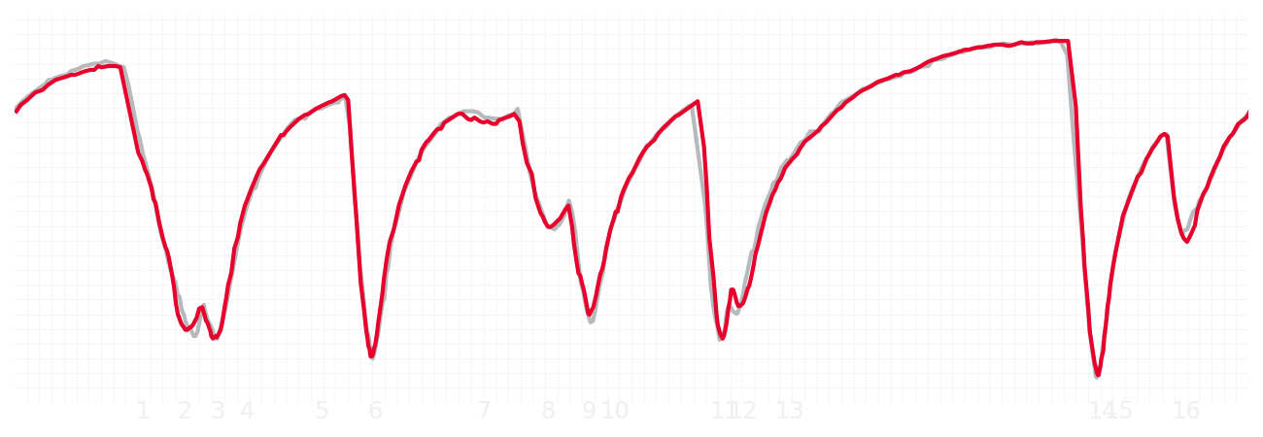
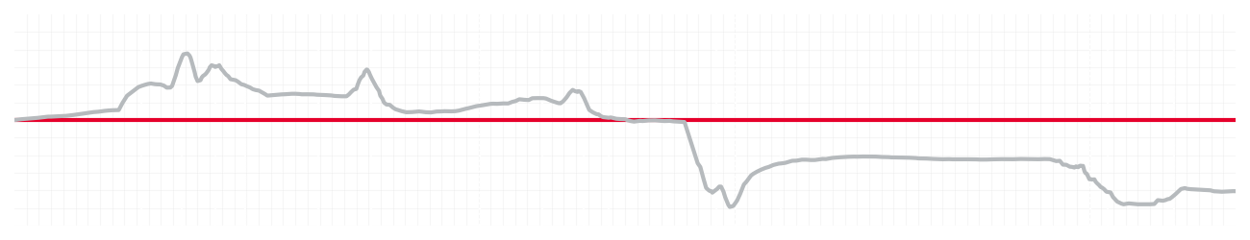
Chinese GP Sprint Quali Q1
Esteban Ocon
Driver
Ollie Bearman
Driver
Lap Time
01:32.651
01:32.269
Lap Time
Sector 1
24.702
Speed Trap 1
279 kp/h
Speed Trap 1
280 kp/h
Sector 1
24.768
Sector 2
27.798
Speed Trap 2
275 kp/h
Gap
0.382
Gap
-0.382
Speed Trap 2
275 kp/h
Sector 2
27.645
Sector 3
40.151
Speed Final Line
265 kp/h
Corner Advantage
11/17
Corner Advantage
6/17
Speed Final Line
266 kp/h
Sector 3
39.856
FULL THROTTLE
55%
54%
FULL THROTTLE
HEAVY BREAKING
22%
20%
HEAVY BREAKING
%LAP TIME
CORNERING
23%
26%
CORNERING
%LAP TIME
SPEED
SPEED
DELTA TIME
DELTA TIME

Slide 10

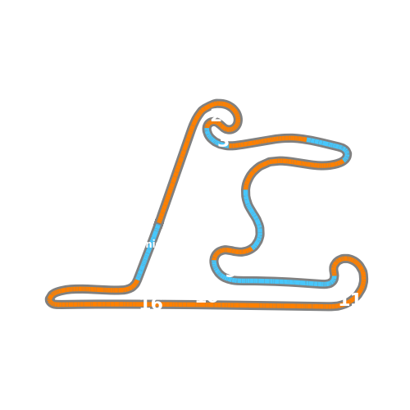


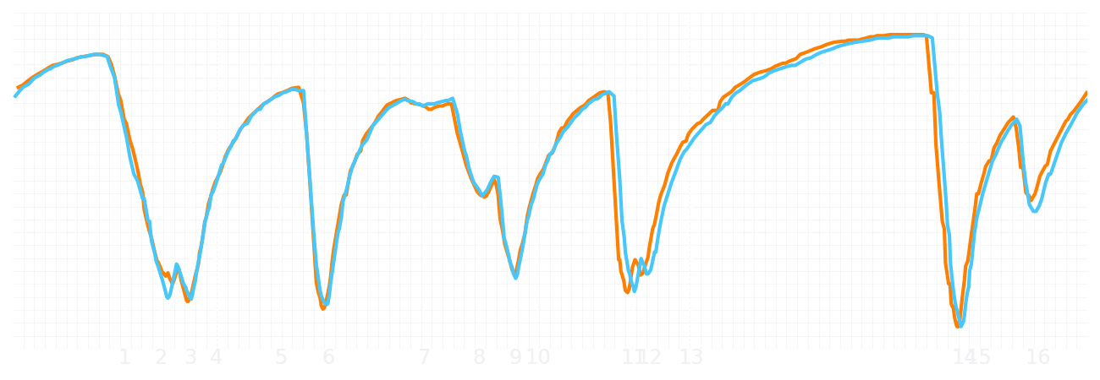
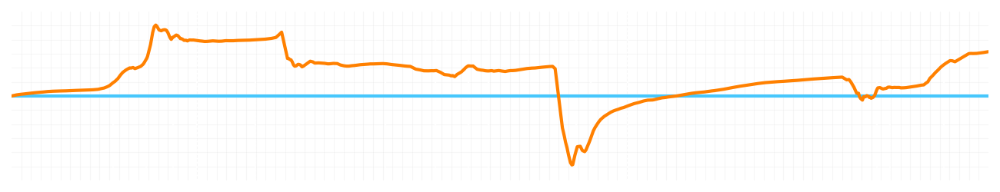
Chinese GP Sprint Quali Q1
Lando Norris
Driver
Oscar Piastri
Driver
Lap Time
01:31.396
01:31.723
Lap Time
Sector 1
24.207
Speed Trap 1
281 kp/h
Speed Trap 1
280 kp/h
Sector 1
24.509
Sector 2
27.555
Speed Trap 2
276 kp/h
Gap
-0.327
Gap
0.327
Speed Trap 2
275 kp/h
Sector 2
27.478
Sector 3
39.634
Speed Final Line
273 kp/h
Corner Advantage
5/17
Corner Advantage
12/17
Speed Final Line
271 kp/h
Sector 3
39.736
FULL THROTTLE
56%
56%
FULL THROTTLE
HEAVY BREAKING
19%
20%
HEAVY BREAKING
%LAP TIME
CORNERING
25%
24%
CORNERING
%LAP TIME
SPEED
SPEED
DELTA TIME
DELTA TIME

